Slide 1
Spatial and Multimedia Databases
MCSE506L – Database Systems
Module 4
Part 1

Slide 2
Outline
Motivation
Spatial and Geographic Data
CAD data
Geographic Data
Representation of Geometric Information
Design Database
Geographic Data
Applications of Geographic Data
Raster Data
Vector Data
Spatial Queires
Indexing of Spatial Data
K-d trees
Quadtrees
R- Trees
Search
Insertion
Deletion

Slide 3
Spatial and Temporal Data and Mobility
For most of the history of databases, the types of data stored in databases were relatively simple, and this was reflected in the rather limited support for data types in earlier versions of SQL.
Over time, however, there developed increasing need for handling more complex data types in databases, such as temporal data, spatial data, and multimedia data.
Another major trend has created its own set of issues: the growth of mobile computers, starting with laptop computers and pocket organizers and extending in more recent years to mobile phones with built-in computers and a variety of wearable computers that are increasingly used in commercial applications.

Slide 4
Motivation
Temporal data:
Most database systems model the current state of the world, for instance, current customers, current students, and courses currently being offered.
In many applications, it is very important to store and retrieve information about past states. Historical information can be incorporated manually into a schema design.

Slide 5
Motivation
Spatial data:
It include geographic data, such as maps and associated information, and computer-aided-design data, such as integrated circuit designs or building designs.
Applications of spatial data initially stored data as files in a file system, as did early-generation business applications. But as the complexity and volume of the data, and the number of users, have grown, ad hoc approaches to storing and retrieving data in a file system have proved insufficient for the needs of many applications that use spatial data.
Spatial-data applications require facilities offered by a database system in particular, the ability to store and query large amounts of data efficiently.
Some applications may also require other database features, such as atomic updates to parts of the stored data, durability, and concurrency control.

Slide 6
Motivation
Multimedia data:
The features required in database systems that store multimedia data such as image, video, and audio data.
The main distinguishing feature of video and audio data is that the display of the data requires retrieval at a steady, predetermined rate; hence, such data are called continuous-media data.

Slide 7
Motivation
Mobile data:
The database requirements of mobile computing systems, such as laptop and netbook computers and high-end cell phones that are connected to base stations via wireless digital communication networks.
Such computers may need to be able to operate while disconnected from the network, unlike the distributed database systems.
They also have limited storage capacity, and thus require special techniques for memory management.

Slide 8
Spatial and Geographic Data

Slide 9
Spatial and Geographic Data
Spatial data support in databases is important for efficiently storing, indexing, and querying of data on the basis of spatial locations.
For example, suppose that we want to store a set of polygons in a database and to query the database to find all polygons that intersect a given polygon.
It cannot use standard index structures, such as B-trees or hash indices, to answer such a query efficiently.
Efficient processing of the above query would require special-purpose index structures, such as R-trees (which we study later) for the task.

Slide 10
Types of Spatial Data
Computer-aided-design (CAD)data, which includes spatial information about how objects—such as buildings, cars, or aircraft—are constructed. Other important examples of computer-aided-design databases are integrated-circuit and electronic-device layouts.
Geographic data such as road maps, land-usage maps, topographic elevation maps, political maps showing boundaries, land-ownership maps, and so on. Geographic information systems are special-purpose databases tailored for storing geographic data.

Slide 11
Representation of Geometric Information
Various geometric constructs can be represented in a database in a normalized fashion.
Represent a line segment by the coordinates of its endpoints.
Approximate a curve by partitioning it into a sequence of segments
Closed polygons

Slide 12
Representation of Geometric Information
A line segment can be represented by the coordinates of its endpoints. For example, in a map database, the two coordinates of a point would be its latitude and longitude.
A polyline (also called a linestring) consists of a connected sequence of line segments and can be represented by a list containing the coordinates of the endpoints of the segments, in sequence.
Curve can approximately represent by polylines, by partitioning the curve into a sequence of segments.
This representation is useful for two-dimensional features such as roads; here, the width of the road is small enough relative to the size of the full map that it can be considered to be a line.
Some systems also support circular arcs as primitives, allowing curves to be represented as sequences of arcs.

Slide 13
Representation of Geometric Information
A polygon can be represented by listing its vertices in order. The list of vertices specifies the boundary of a polygonal region.
A polygon can be divided into a set of triangles, this process is called triangulation, and any polygon can be triangulated.
The complex polygon can be given an identifier, and each of the triangles into which it is divided carries the identifier of the polygon.
Circles and ellipses can be represented by corresponding types, or can be approximated by polygons.

Slide 14
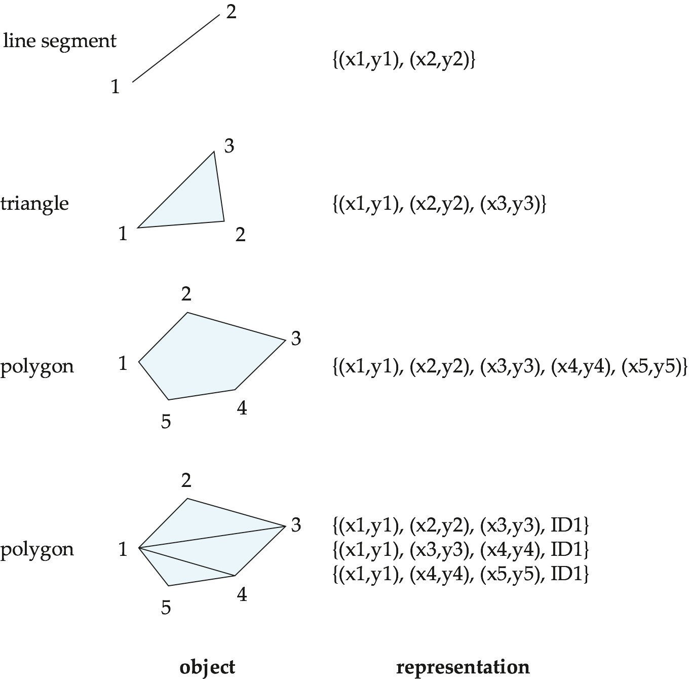

Slide 15
Representation of Geometric Information
List-based representations of polylines or polygons are often convenient for query processing. Such non-first-normal-form representations are used when supported by the underlying database.
Using fixed-size tuples (in first normal form) for representing polylines, we can give the polyline or curve an identifier, and can represent each segment as a separate tuple that also carries with it the identifier of the polyline or curve.
Similarly, the triangulated representation of polygons allows a first normal form relational representation of polygons.

Slide 16
Representation of Geometric Information
The representation of points and line segments in three-dimensional space is similar to their representation in two-dimensional space, the only difference being that points have an extra z component.
The representation of planar figures—such as triangles, rectangles, and other polygons—does not change much when we move to three dimensions.
Tetrahedrons and cuboids can be represented in the same way as triangles and rectangles.
It can represent arbitrary polyhedra by dividing them into tetrahedrons, just as we triangulate polygons.

Slide 17
Design Database
Represent design components as objects (generally geometric objects); the connections between the objects indicate how the design is structured.
Simple two-dimensional objects: points, lines, triangles, rectangles, polygons.
Complex two-dimensional objects: formed from simple objects via union, intersection, and difference operations.
Complex three-dimensional objects: formed from simpler objects such as spheres, cylinders, and cuboids, by union, intersection, and difference operations.
Wireframe models represent three-dimensional surfaces as a set of simpler objects.

Slide 18
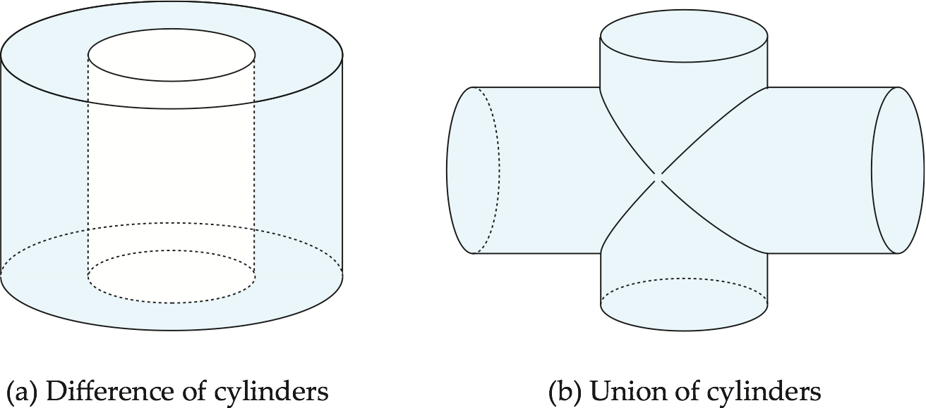
Design Database
Design databases also store non-spatial information about objects (e.g., construction material, color, etc.)
Spatial integrity constraints are important.
E.g., pipes should not intersect, wires should not be too close to each other, etc.

Slide 19
Geographic Data
Raster data consist of bit maps or pixel maps, in two or more dimensions.
Example 2-D raster image: satellite image of cloud cover, where each pixel stores the cloud visibility in a particular area.
Additional dimensions might include the temperature at different altitudes at different regions, or measurements taken at different points in time.
Design databases generally do not store raster data.

Slide 20
Geographic Data
Vector data are constructed from basic geometric objects: points, line segments, triangles, and other polygons in two dimensions, and cylinders, spheres, cuboids, and other polyhedrons in three dimensions.
Vector format often used to represent map data.
Roads can be considered as two-dimensional and represented by lines and curves.
Some features, such as rivers, may be represented either as complex curves or as complex polygons, depending on whether their width is relevant.
Features such as regions and lakes can be depicted as polygons.

Slide 21
Applications of Geographic Data
Examples of geographic data
map data for vehicle navigation
distribution network information for power, telephones, water supply, and sewage
Vehicle navigation systems store information about roads and services for the use of drivers:
Spatial data: e.g., road/restaurant/gas-station coordinates
Non-spatial data: e.g., one-way streets, speed limits, traffic congestion
Global Positioning System (GPS) unit - utilizes information broadcast from GPS satellites to find the current location of user with an accuracy of tens of meters.
increasingly used in vehicle navigation systems as well as utility maintenance applications.

Slide 22
Spatial Queries
Nearness queries request objects that lie near a specified location.
Nearest neighbor queries, given a point or an object, find the nearest object that satisfies given conditions.
Region queries deal with spatial regions. e.g., ask for objects that lie partially or fully inside a specified region.
Queries that compute intersections or unions of regions.
Spatial join of two spatial relations with the location playing the role of join attribute.

Slide 23
Spatial Queries
Spatial data is typically queried using a graphical query language; results are also displayed in a graphical manner.
Graphical interface constitutes the front-end
Extensions of SQL with abstract data types, such as lines, polygons and bit maps, have been proposed to interface with back-end.
allows relational databases to store and retrieve spatial information
Queries can use spatial conditions (e.g., contains or overlaps).
queries can mix spatial and nonspatial conditions

Slide 24
Indexing of Spatial Queries
To understand how to index spatial data consisting of two or more dimensions, we consider first the indexing of points in one-dimensional data.
Tree structures, such as binary trees and B-trees, operate by successively dividing space into smaller parts.
For instance, each internal node of a binary tree partitions a one dimensional interval in two.
Points that lie in the left partition go into the left subtree; points that lie in the right partition go into the right subtree.
Ina balanced binary tree, the partition is chosen so that approximately one-half of the points stored in the subtree fall in each partition.
Each level of a B-tree splits a one-dimensional interval into multiple parts.

Slide 25
Indexing of Spatial Queries
To understand how to index spatial data consisting of two or more dimensions, we consider first the indexing of points in one-dimensional data.
Tree structures, such as binary trees and B-trees, operate by successively dividing space into smaller parts.
For instance, each internal node of a binary tree partitions a one dimensional interval in two.
Points that lie in the left partition go into the left subtree; points that lie in the right partition go into the right subtree.
Ina balanced binary tree, the partition is chosen so that approximately one-half of the points stored in the subtree fall in each partition.
Each level of a B-tree splits a one-dimensional interval into multiple parts.

Slide 26
Indexing of Spatial Queries
k-d tree - early structure used for indexing in multiple dimensions.
Each level of a k-d tree partitions the space into two.
choose one dimension for partitioning at the root level of the tree.
choose another dimensions for partitioning in nodes at the next level and so on, cycling through the dimensions.
In each node, approximately half of the points stored in the sub-tree fall on one side and half on the other.
Partitioning stops when a node has less than a given maximum number of points.
The k-d-B tree extends the k-d tree to allow multiple child nodes for each internal node; well-suited for secondary storage.

Slide 27
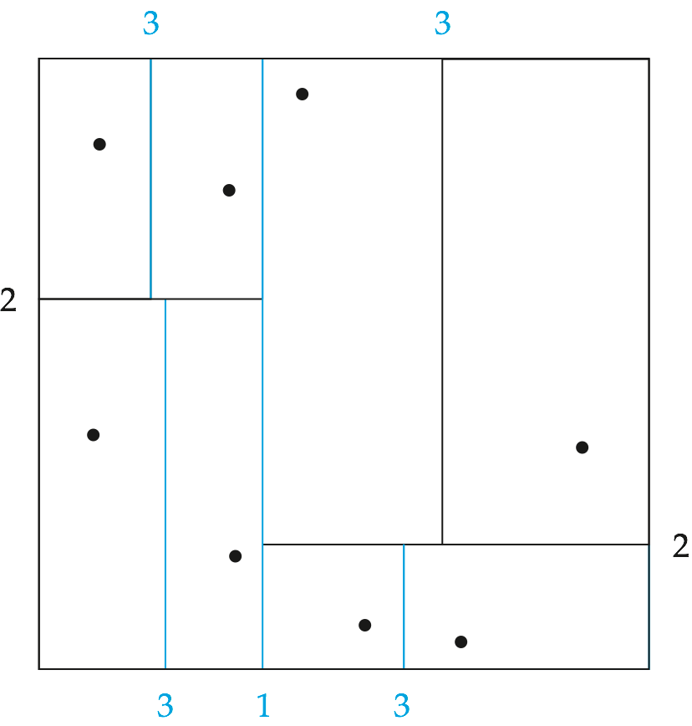
Indexing of Spatial Queries
Each line in the figure (other than the outside box) corresponds to a node in the k-d tree.
The maximum number of points in a leaf node has been set to 1.
The numbering of the lines in the figure indicates the level of the tree at which the corresponding node appears.
k-d-B tree extends the k-d tree to allow multiple child nodes for each internal node, just as a B-tree extends a binary tree, to reduce the height of the tree.
k-d-B trees are better suited for secondary storage than k-d trees.

Slide 28
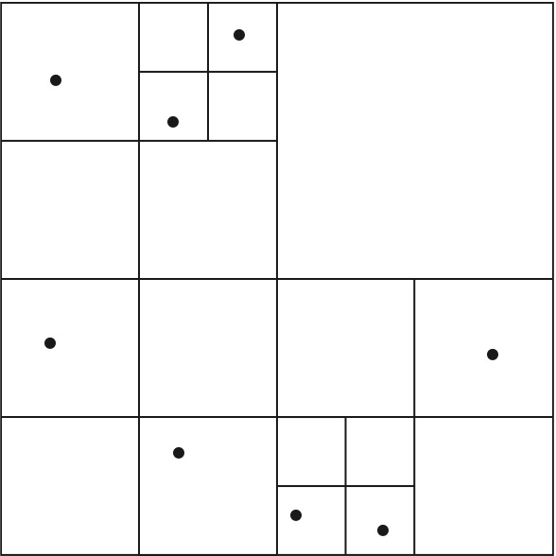
Indexing of Spatial Queries
Quadtrees
Each node of a quadtree is associated with a rectangular region of space; the top node is associated with the entire target space.
Each non-leaf nodes divides its region into four equal sized quadrants
Correspondingly each such node has four child nodes corresponding to the four quadrants and so on
Leaf nodes have between zero and some fixed maximum number of points (set to 1 in example).

Slide 29
Quadtrees
PR quadtree: stores points; space is divided based on regions, rather than on the actual set of points stored.
Region quadtrees store array (raster) information.
A node is a leaf node is all the array values in the region that it covers are the same. Otherwise, it is subdivided further into four children of equal area, and is therefore an internal node.
Each node corresponds to a sub-array of values.
The sub-arrays corresponding to leaves either contain just a single array element, or have multiple array elements, all of which have the same value.
Extensions of k-d trees and PR quadtrees have been proposed to index line segments and polygons
Require splitting segments/polygons into pieces at partitioning boundaries
Same segment/polygon may be represented at several leaf nodes

Slide 30
R-trees
R-trees are a N-dimensional extension of B⁺-trees, useful for indexing sets of rectangles and other polygons.
Supported in many modern database systems, along with variants like R⁺ -trees and R*-trees.
Basic idea: generalize the notion of a one-dimensional interval associated with each B+ -tree node to an N-dimensional interval, that is, an N-dimensional rectangle.
Will consider only the two-dimensional case (N = 2)
generalization for N > 2 is straightforward, although R-trees work well only for relatively small N

Slide 31
R-trees
A storage structure called an R-tree is useful for indexing of objects such as points, line segments, rectangles, and other polygons.
An R-tree is a balanced tree structure with the indexed objects stored in leaf nodes, much like a B+-tree.
Instead of a range of values, a rectangular bounding box is associated with each tree node.
The bounding box of a leaf node is the smallest rectangle parallel to the axes that contains all objects stored in the leaf node.
The bounding box of internal nodes is, similarly, the smallest rectangle parallel to the axes that contains the bounding boxes of its child nodes.
The bounding box of an object (such as a polygon) is defined, similarly, as the smallest rectangle parallel to the axes that contains the object.

Slide 32
R-trees
A rectangular bounding box is associated with each tree node.
Bounding box of a leaf node is a minimum sized rectangle that contains all the rectangles/polygons associated with the leaf node.
The bounding box associated with a non-leaf node contains the bounding box associated with all its children.
Bounding box of a node serves as its key in its parent node (if any)
Bounding boxes of children of a node are allowed to overlap
A polygon is stored only in one node, and the bounding box of the node must contain the polygon.
The storage efficiency or R-trees is better than that of k-d trees or quadtrees since a polygon is stored only once.

Slide 33
R-trees
Each internal node stores the bounding boxes of the child nodes along with the pointers to the child nodes.
Each leaf node stores the indexed objects, and may optionally store the bounding boxes of the objects; the bounding boxes help speed up checks for overlaps of the rectangle with the indexed objects
If a query rectangle does not overlap with the bounding box of an object, it cannot overlap with the object, either. (If the indexed objects are rectangles, there is of course no need to store bounding boxes, since they are identical to the rectangles.)

Slide 34
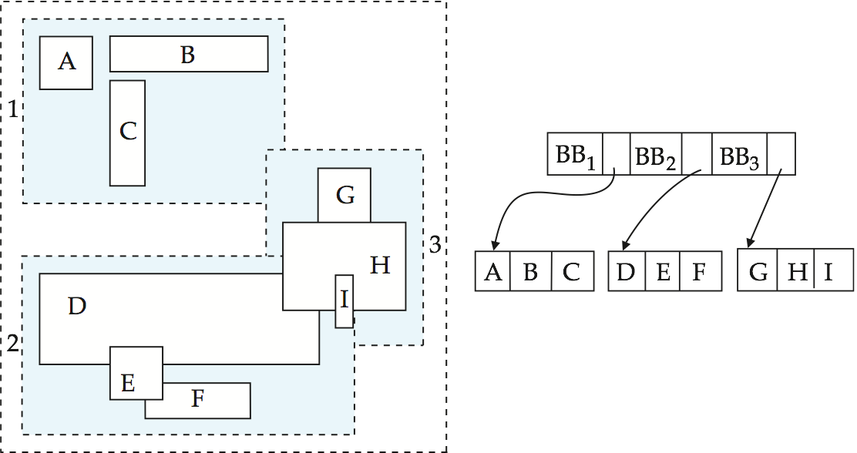
R-trees
A set of rectangles (solid line) and the bounding boxes (dashed line) of the nodes of an R-tree for the rectangles. The R-tree is shown on the right.

Slide 35
Search in R-trees
To find data items (rectangles/polygons) intersecting (overlaps) a given query point/region, do the following, starting from the root node:
If the node is a leaf node, output the data items whose keys intersect the given query point/region.
Else, for each child of the current node whose bounding box overlaps the query point/region, recursively search the child
Can be very inefficient in worst case since multiple paths may need to be searched
but works acceptably in practice.
Simple extensions of search procedure to handle predicates contained-in and contains

Slide 36
Insertion in R-trees
To insert a data item:
Find a leaf to store it, and add it to the leaf
To find leaf, follow a child (if any) whose bounding box contains bounding box of data item, else child whose overlap with data item bounding box is maximum
Handle overflows by splits (as in B+-trees)
Split procedure is different though (see below)
Adjust bounding boxes starting from the leaf upwards
Split procedure:
Goal: divide entries of an overfull node into two sets such that the bounding boxes have minimum total area
This is a heuristic. Alternatives like minimum overlap are possible
Finding the “best” split is expensive, use heuristics instead

Slide 37
Splitting an R-trees Node
Quadratic split divides the entries in a node into two new nodes as follows
Find pair of entries with “maximum separation”
that is, the pair such that the bounding box of the two would has the maximum wasted space (area of bounding box – sum of areas of two entries)
Place these entries in two new nodes
Repeatedly find the entry with “maximum preference” for one of the two new nodes, and assign the entry to that node
Preference of an entry to a node is the increase in area of bounding box if the entry is added to the other node
Stop when half the entries have been added to one node
Then assign remaining entries to the other node
Cheaper linear split heuristic works in time linear in number of entries,
Cheaper but generates slightly worse splits.

Slide 38
Deleting in R-trees
Deletion of an entry in an R-tree done much like a B⁺-tree deletion.
In case of underfull node, borrow entries from a sibling if possible, else merging sibling nodes
Alternative approach removes all entries from the underfull node, deletes the node, then reinserts all entries

Slide 39
Operations in Spatial Data
Measurement: Computes geometry distance, polygon area, line length, etc.
Geoprocessing: Create new features by changing existing ones, for as by surrounding them with a buffer or by intersecting features.
Geometry Constructors: Specifies the vertices (points or nodes) that define the form to create new geometries.
Observer Functions: Queries that give detailed answers on a feature, like the location of a circle's center.
Predicates: True/false questions about the spatial relationships between geometries are permissible.

Slide 40
Spatial Operators
Spatial operators : Spatial operators these operators are applied in geometric properties of objects.
It is then used in the physical space to capture them and the relation among them. It is also used to perform spatial analysis.
Spatial operators are grouped into three categories :
Topological operators
Projective Operators
Metric operators
Notes:
https://www.geeksforgeeks.org/spatial-operators-dynamic-spatial-operators-and-spatial-queries-in-dbms/

Slide 41
Spatial Operators
Topological operators : Topological properties do not vary when topological operations are applied, like translation or rotation.
Topological operators are hierarchically structured in many levels.
The base level offers operators, ability to check for detailed topological relations between regions with a broad boundary.
The higher levels offer more abstract operators that allow users to query uncertain spatial data independent of the geometric data model.
Examples – open (region), close (region), and inside (point, loop).
Notes:
https://www.geeksforgeeks.org/spatial-operators-dynamic-spatial-operators-and-spatial-queries-in-dbms/

Slide 42
Spatial Operators
Projective operators : Projective operators, like convex hull are used to establish predicates regarding the concavity convexity of objects.
Example – Having inside the object’s concavity.
Metric operators : Metric operators' task is to provide a more accurate description of the geometry of the object. They are often used to measure the global properties of singular objects, and to measure the relative position of different objects, in terms of distance and direction.
Example – length (of an arc) and distance (of a point to point).
Notes:
https://www.geeksforgeeks.org/spatial-operators-dynamic-spatial-operators-and-spatial-queries-in-dbms/

Slide 43
Spatial Operators
Dynamic Spatial Operators : Dynamic operations changes the objects upon which the operators are applied. Create, destroy, and update are the fundamental dynamic operations.
Example – Updation of a spatial object via translate, rotate, scale up or scale down, reflect, and shear.
Notes:
https://www.geeksforgeeks.org/spatial-operators-dynamic-spatial-operators-and-spatial-queries-in-dbms/

Slide 44
Spatial Operators
Dynamic Spatial Operators : Dynamic operations changes the objects upon which the operators are applied. Create, destroy, and update are the fundamental dynamic operations.
Example – Updation of a spatial object via translate, rotate, scale up or scale down, reflect, and shear.
Notes:
https://www.geeksforgeeks.org/spatial-operators-dynamic-spatial-operators-and-spatial-queries-in-dbms/

Slide 45
Spatial Operators in Oracle
SDO_FILTER | Specifies which geometries may interact with a given geometry.
SDO_JOIN | Performs a spatial join based on one or more topological relationships.
SDO_NN | Determines the nearest neighbor geometries to a geometry.
SDO_NN_DISTANCE | Returns the distance of an object returned by the SDO_NN operator.
SDO_POINTINPOLYGON | Takes a set of rows whose first column is a point's x-coordinate value and the second column is a point's y-coordinate value, and returns those rows that are within a specified polygon geometry.
SDO_RELATE | Determines whether or not two geometries interact in a specified way. (See also Table 18-2 for convenient alternative operators for performing specific mask value operations.)
SDO_WITHIN_DISTANCE | Determines if two geometries are within a specified distance from one another.
Notes:
https://docs.oracle.com/database/121/SPATL/spatial-operators.htm#SPATL110

Slide 46
Spatial Operators in Oracle
SDO_ANYINTERACT | Checks if any geometries in a table have the ANYINTERACT topological relationship with a specified geometry.
SDO_CONTAINS | Checks if any geometries in a table have the CONTAINS topological relationship with a specified geometry.
SDO_COVEREDBY | Checks if any geometries in a table have the COVEREDBY topological relationship with a specified geometry.
SDO_COVERS | Checks if any geometries in a table have the COVERS topological relationship with a specified geometry.
SDO_EQUAL | Checks if any geometries in a table have the EQUAL topological relationship with a specified geometry.
Notes:
https://www.geeksforgeeks.org/spatial-operators-dynamic-spatial-operators-and-spatial-queries-in-dbms/

Slide 47
Spatial Operators in Oracle
SDO_INSIDE | Checks if any geometries in a table have the INSIDE topological relationship with a specified geometry.
SDO_ON | Checks if any geometries in a table have the ON topological relationship with a specified geometry.
SDO_OVERLAPBDYDISJOINT | Checks if any geometries in a table have the OVERLAPBDYDISJOINT topological relationship with a specified geometry.
SDO_OVERLAPBDYINTERSECT | Checks if any geometries in a table have the OVERLAPBDYINTERSECT topological relationship with a specified geometry.
SDO_OVERLAPS | Checks if any geometries in a table overlap (that is, have the OVERLAPBDYDISJOINT or OVERLAPBDYINTERSECT topological relationship with) a specified geometry.
SDO_TOUCH | Checks if any geometries in a table have the TOUCH topological relationship with a specified geometry.
Notes:
https://www.geeksforgeeks.org/spatial-operators-dynamic-spatial-operators-and-spatial-queries-in-dbms/

Slide 48
Spatial Query
A spatial query is a special type of database query supported by spatial databases, including geodatabases.
The queries differ from non-spatial SQL queries in several important ways.
Two of the most important are that they allow for the use of geometry data types such as points, lines and polygons and that these queries consider the spatial relationship between these geometries.
The function names for queries differ across geodatabases. The following are a few of the functions built into PostGIS, a free geodatabase which is a PostgreSQL extension (the term 'geometry' refers to a point, line, box or other two or three dimensional shape)

Slide 49
Spatial Query
The requests for the spatial data which requires the use of spatial operations are called Spatial Queries.It can be divided into –
Range queries : It finds all objects of a particular type that are within a given spatial area.
Example – Finds all hospitals within the Siliguri area. A variation of this query is for a given location, find all objects within a particular distance, for example, find all banks within 5 km range.
Nearest neighbor queries : It Finds object of a particular type which is nearest to a given location.
Example – Finds the nearest police station from the location of accident.
Spatial joins or overlays : It joins the objects of two types based on spatial condition, such as the objects which are intersecting or overlapping spatially.
Example – Finds all Dhabas on a National Highway between two cities. It spatially joins township objects and highway object.
Finds all hotels that are within 5 kilometres of a railway station. It spatially joins railway station objects and hotels objects.

Slide 50
Spatial Query
Function prototype: functionName (parameter(s)) : return type
ST_Distance(geometry, geometry) : number
ST_Equals(geometry, geometry) : boolean
ST_Disjoint(geometry, geometry) : boolean
ST_Intersects(geometry, geometry) : boolean
ST_Touches(geometry, geometry) : boolean
ST_Crosses(geometry, geometry) : boolean
ST_Overlaps(geometry, geometry) : boolean
ST_Contains(geometry, geometry) : boolean
ST_Length(geometry) : number
ST_Area(geometry) : number
ST_Centroid(geometry) : geometry
ST_Intersection(geometry, geometry) : geometry

Slide 51
Spatial Query
Thus, a spatial join between a points layer of cities and a polygon layer of countries could be performed in a spatially-extended SQL statement as:
SELECT * FROM cities, countries WHERE ST_Contains(countries.shape, cities.shape)
The Intersect vector overlay operation (a core element of GIS software) could be replicated as:
SELECT ST_Intersection(veg.shape, soil.shape) int_poly, veg.*, soil.* FROM veg, soil where ST_Intersects(veg.shape, soil.shape)

Slide 52
Spatial Query
Thus, a spatial join between a points layer of cities and a polygon layer of countries could be performed in a spatially-extended SQL statement as:
SELECT * FROM cities, countries WHERE ST_Contains(countries.shape, cities.shape)
The Intersect vector overlay operation (a core element of GIS software) could be replicated as:
SELECT ST_Intersection(veg.shape, soil.shape) int_poly, veg.*, soil.* FROM veg, soil where ST_Intersects(veg.shape, soil.shape)

Slide 53
Thank You!
Spatial Database
Module 4
MCSE506L – Database Systems
Email
karthik.gm@vit.ac.in

